Slide 1
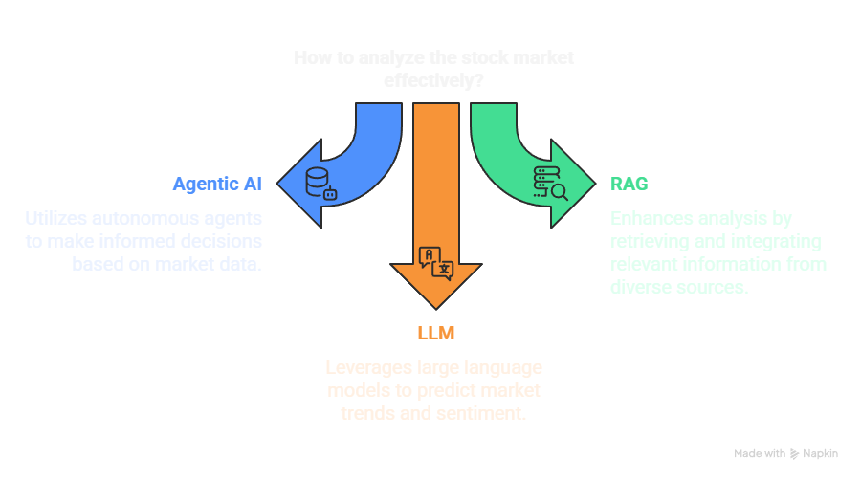
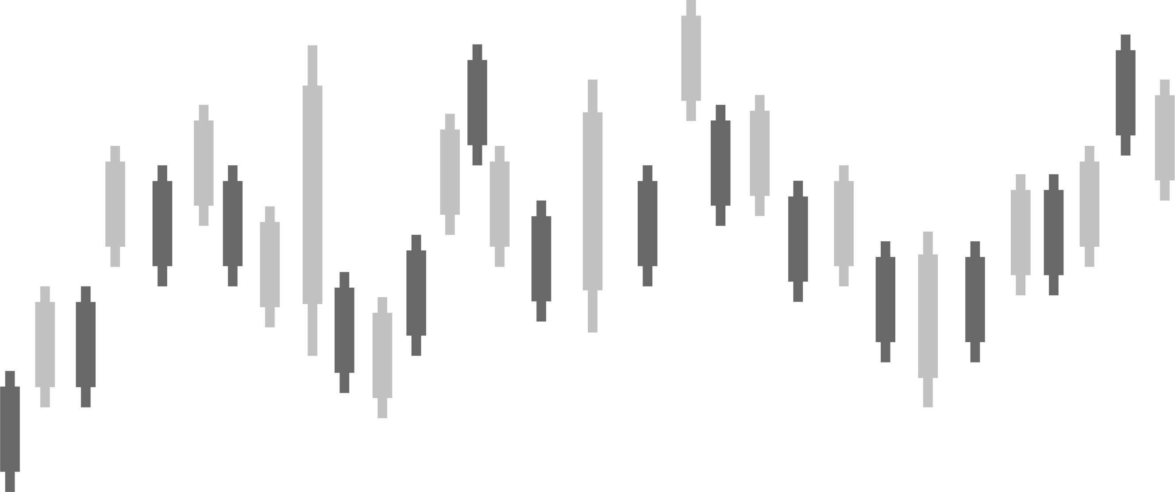

Introduction to
STOCK MARKET
Analysis using
Revolutionizing Financial Insights through Intelligent Automation.
Lets Go!

Slide 2
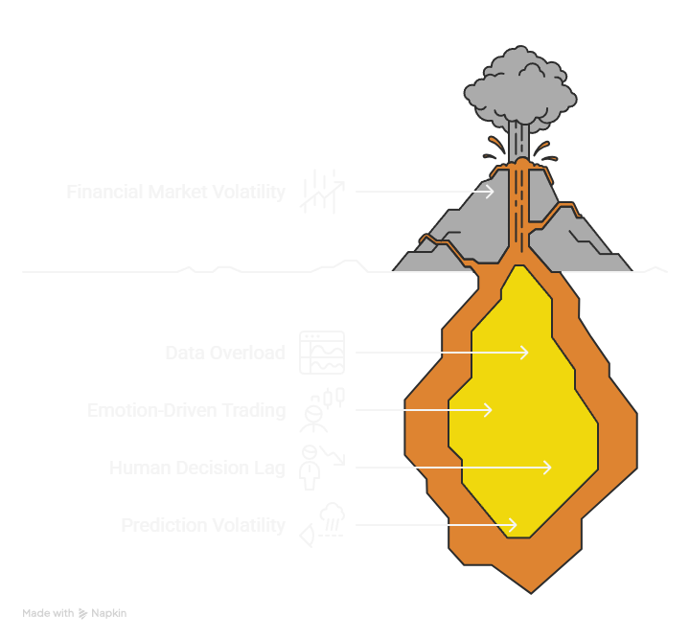
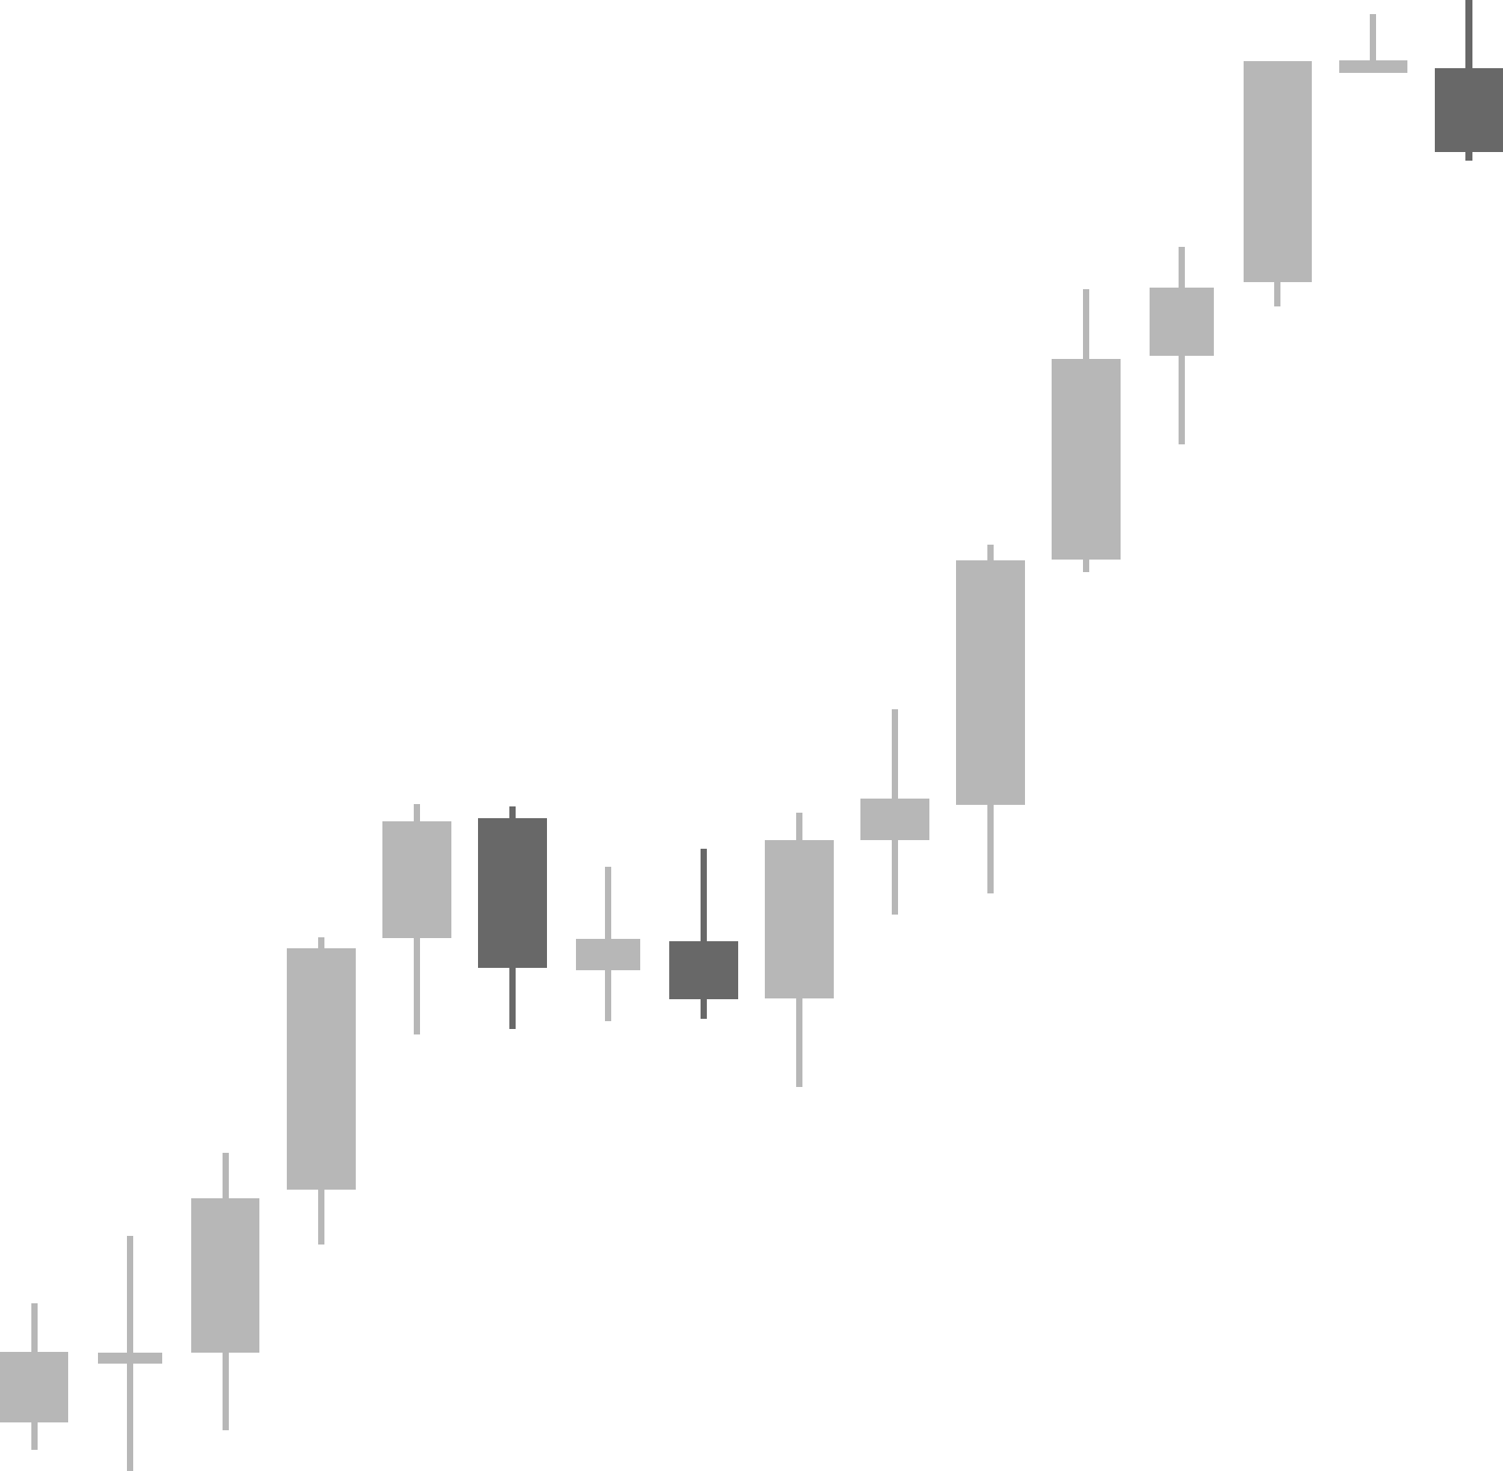
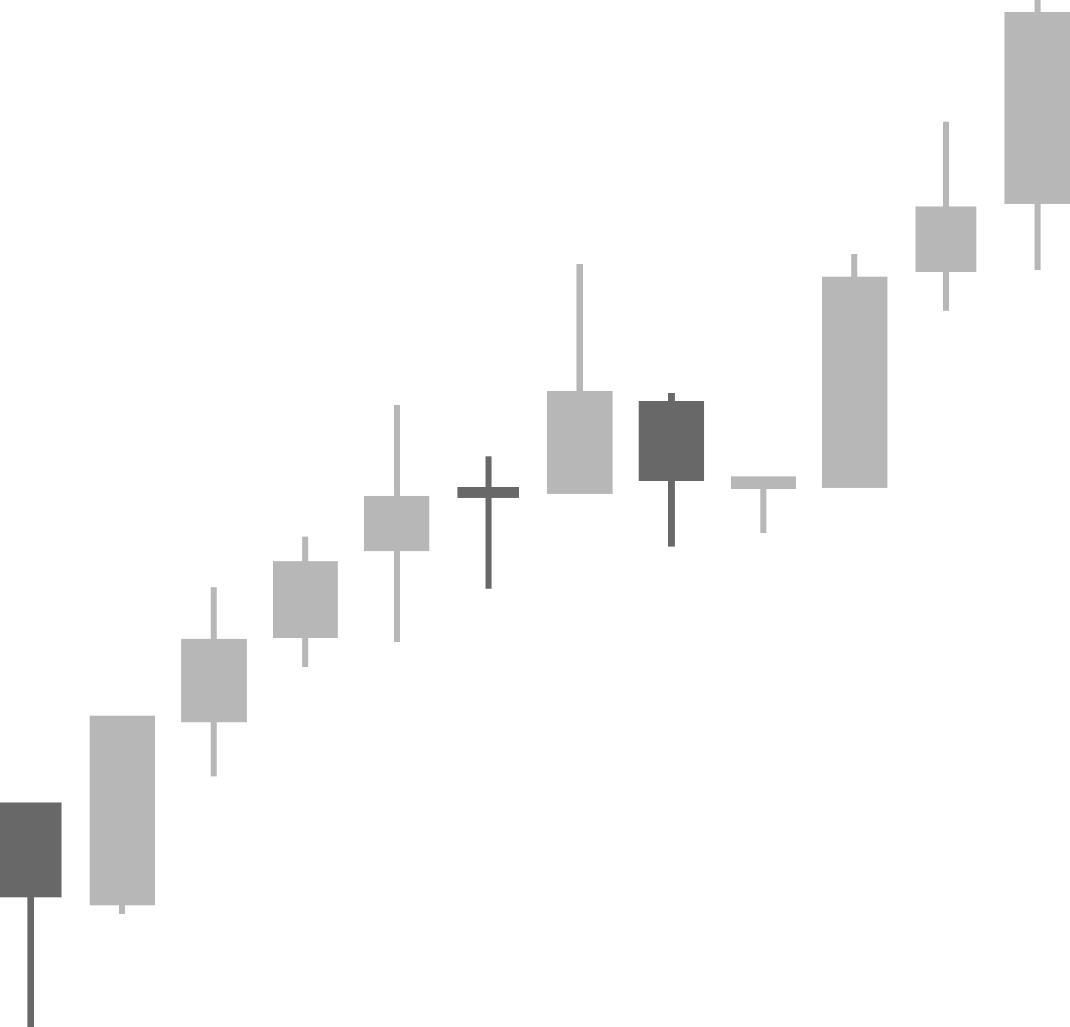
Stock Market Challenges
🔹 Data Overload
Massive, noisy, and unstructured real-time data makes analysis tough.
🔹 Emotional Trading
FOMO, panic, and herd behavior drive irrational market moves.
🔹 Slow Decisions
Manual analysis causes delayed responses to fast changes.
🔹 Unstable Predictions
High uncertainty due to market complexity and sudden shifts.

Slide 3
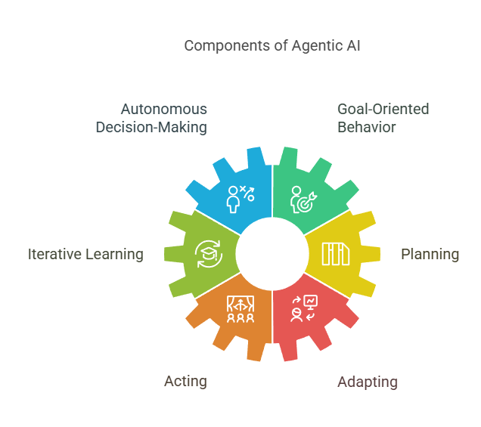
Why Agentic AI & System Architecture
🔍 Why Agentic AI?
  Acts autonomously to gather data and execute tasks
  Continuously learns and adapts to market goals
  Makes intelligent, real-time decisions without manual input
🧠 System Architecture Overview
  Data Ingestion – Market APIs, news feeds, financial sources
  RAG Layer – Retrieves relevant info via vector databases
  LLM Layer – Understands context and generates insights
  Agent Engine – Tools like PHIdata/Polygon drive actions
  Output – Delivers alerts, summaries, and market strategies

Slide 4
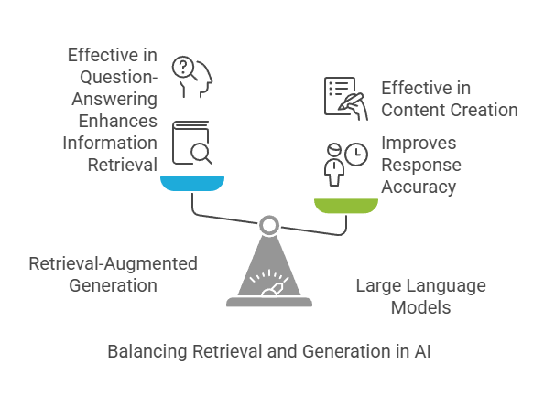
RAG + LLM in Action
  📚 Retrieval-Augmented Generation (RAG)
    📄 Fetches relevant documents or data snippets
    🧠 Builds a context vector for the LLM
  🤖 LLM Integration
    📝 Uses retrieved context to generate accurate, grounded responses
    🚫 Minimizes hallucinations and factual errors
  🔁 Example Flow
    💬 User query: “What’s driving today’s NASDAQ dip?”
    🔍 Retriever: Fetches top-K relevant news articles
    🧾 LLM Output: Synthesizes and presents an evidence-backed answer

Slide 5
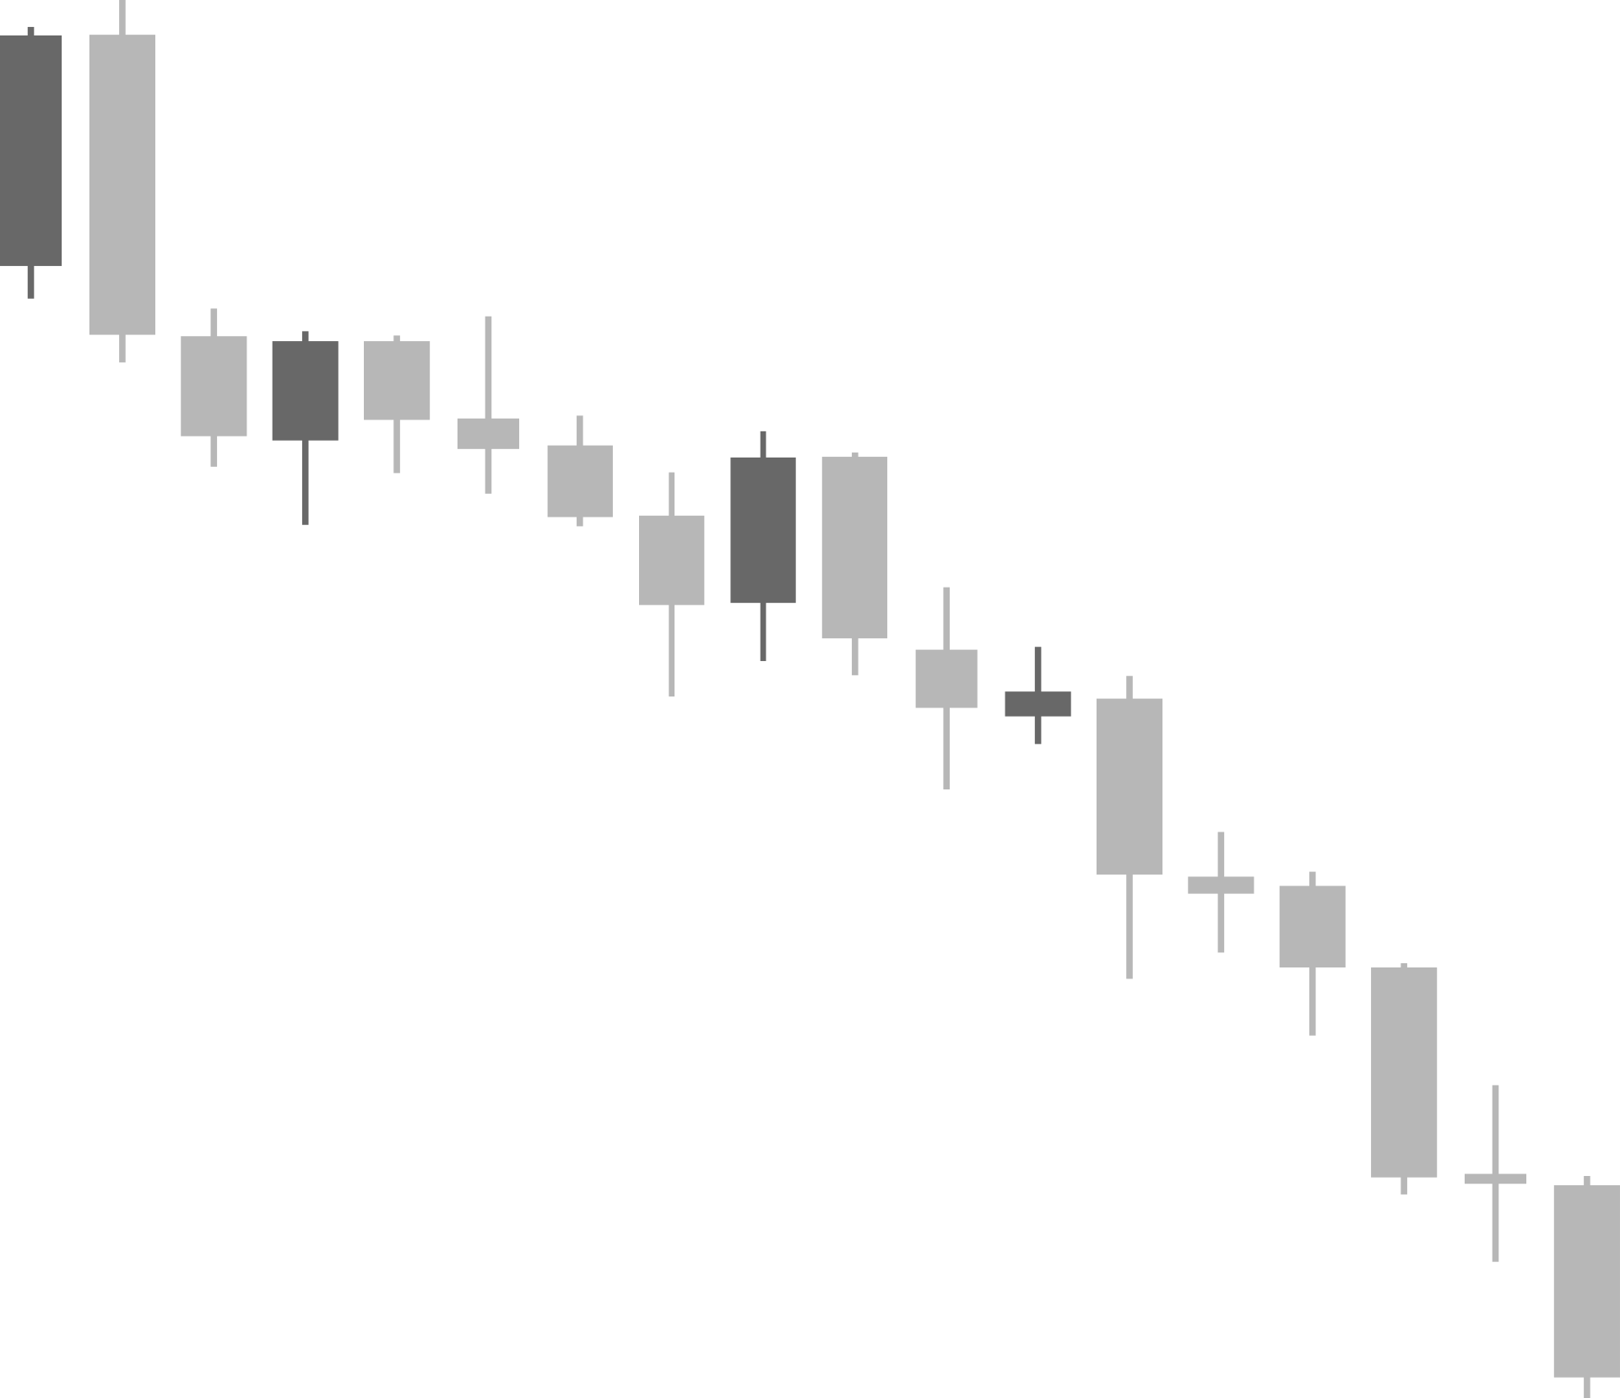
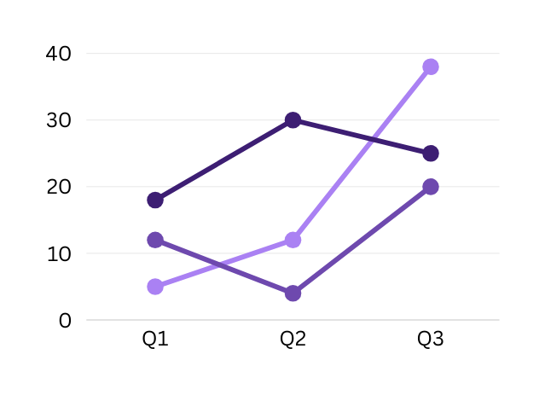
Use Cases of Agentic AI in Stock Market
🔄 Real-Time Trend Analysis
Automatically detects trading patterns and signals from live market data streams.
😊 Sentiment Extraction
Analyzes news and social media to assess public sentiment and market mood.
💼 Portfolio Recommendations
Provides personalized investment suggestions based on user goals and risk profiles.
🚀 Autonomous Trading Signals
Generates actionable buy/sell alerts using real-time insights and agent decisions.
Profit
+$1750
Asset
-489

Slide 6
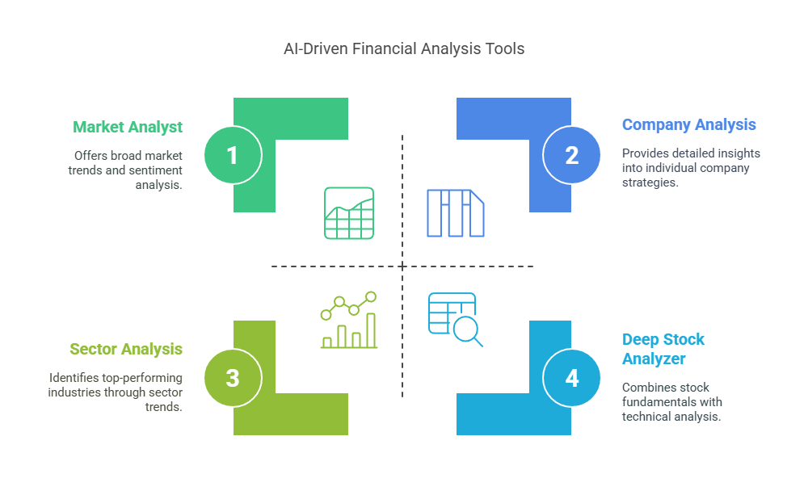
What we provide
📊 Market Analyst 🏢 Sector Analysis📉 Deep Stock Analyzer🏦 Company Analysis.

Slide 7
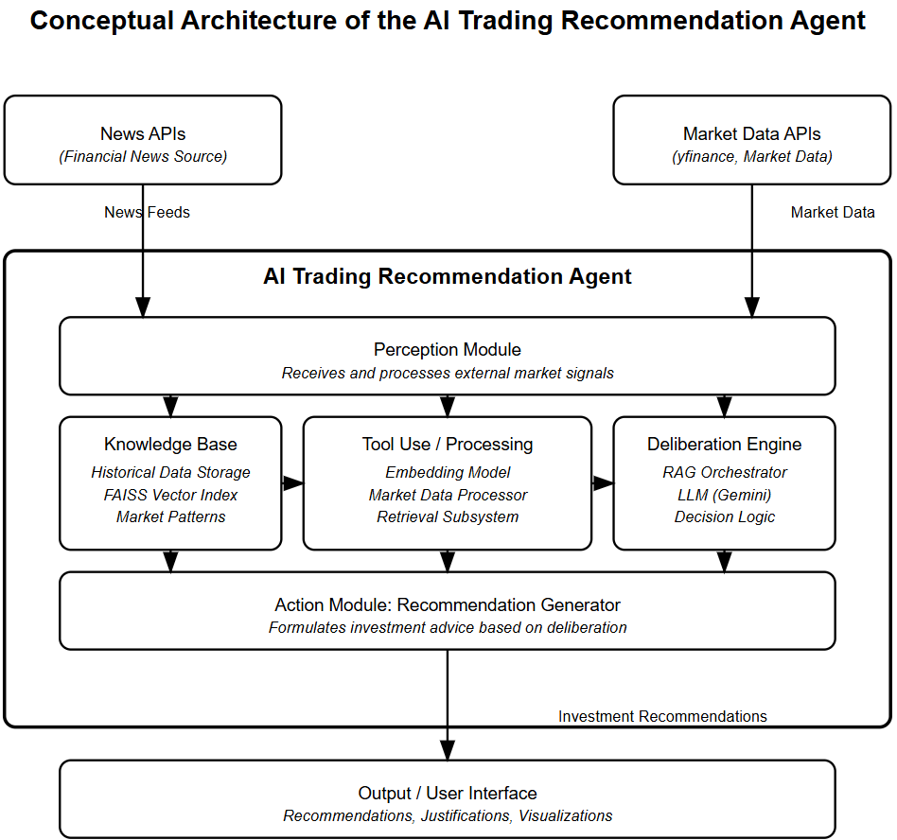



Slide 8

Future in Stock Market
🎙️ Real-Time Voice Assistants
AI-driven voice assistants for stock insights and trading recommendations.
📈 Advanced Algorithmic Trading
Integrating AI with quantitative trading platforms for optimized execution.
🤖 Personalized AI Advisors
Custom financial strategies powered by AI for individual investors.
💡 Benefits
⚡ Faster Decision Making
Real-time insights and alerts for immediate market reactions.
🎯 Improved Accuracy
Data-driven, less emotional decision-making.
⏱️ Increased Efficiency
Automation reduces manual tasks, enhancing overall market analysis speed.
📚 Adaptive Learning
AI continuously improves by learning from real-time data and market conditions.
Predicted
35%

Slide 9


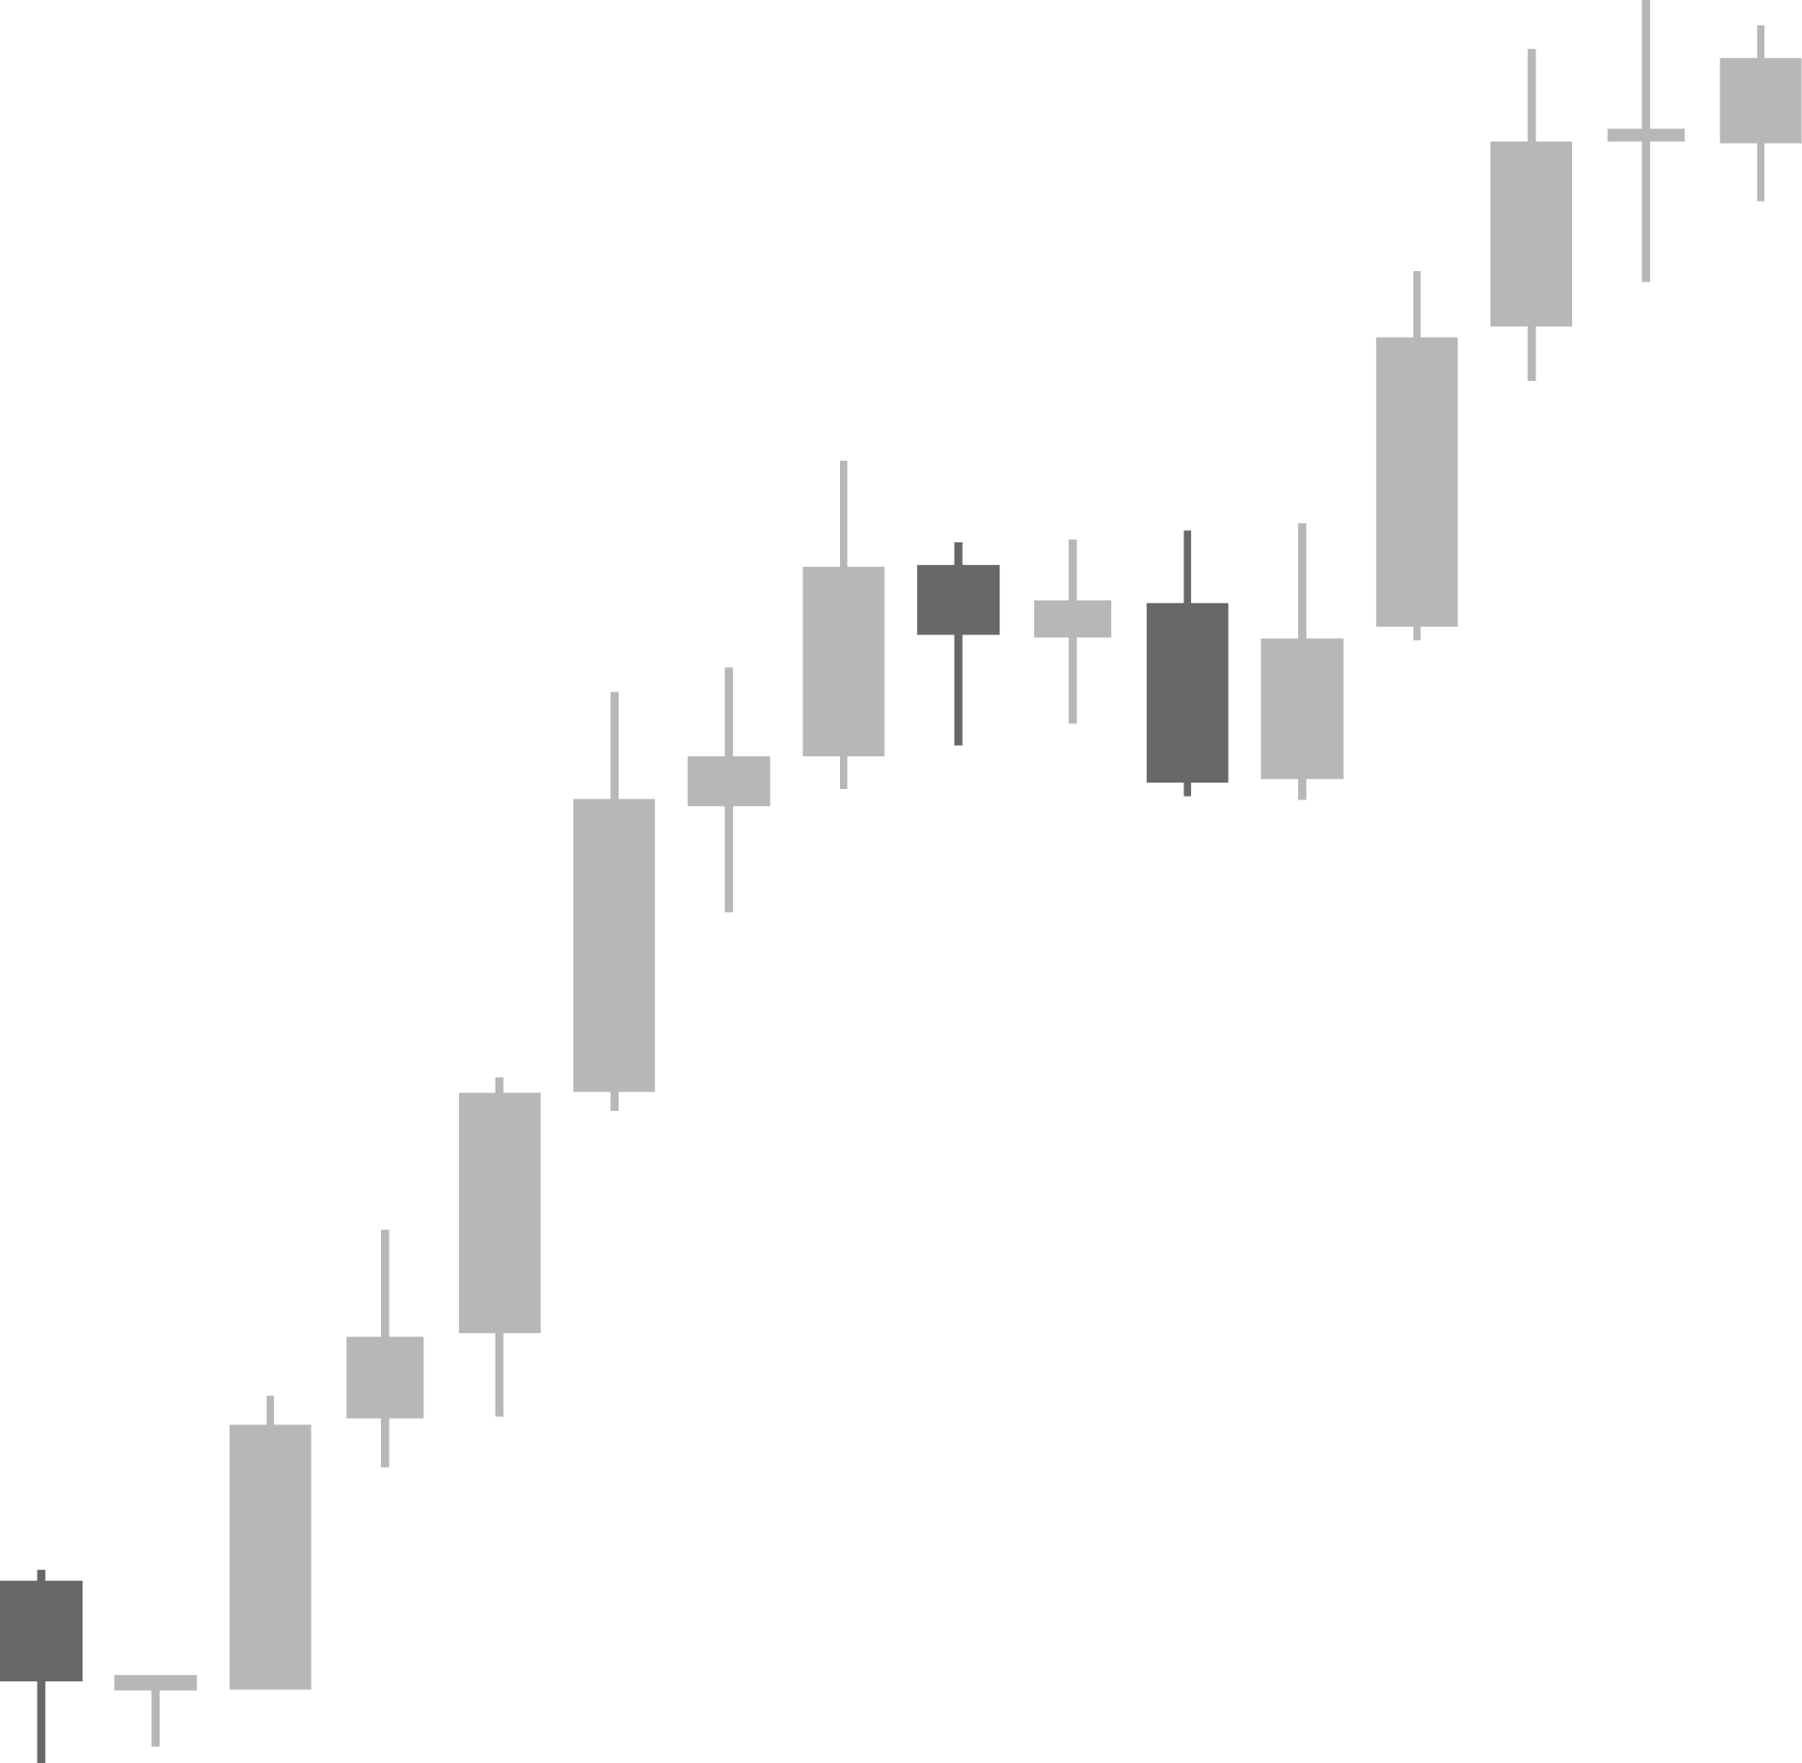
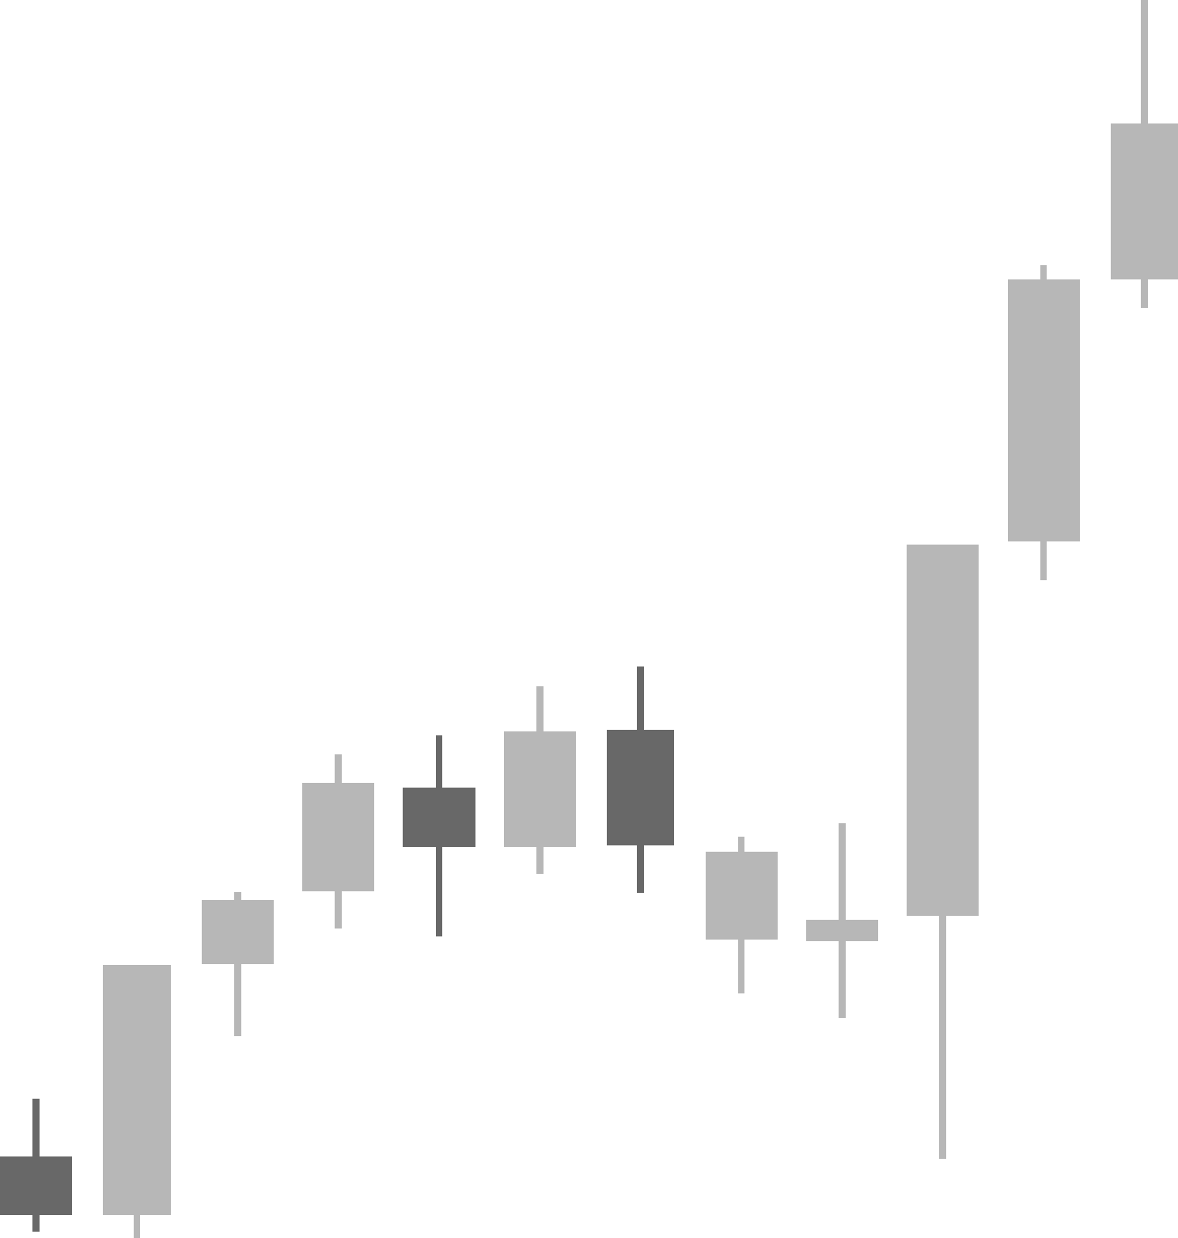
Let’s Start

Slide 10

Thank You

